Slide 1
Spin and Sparse
PHYS3112 – Tutorial 8

Slide 2
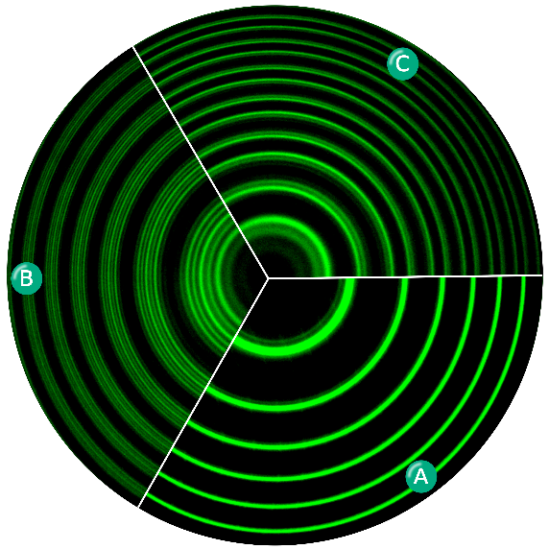
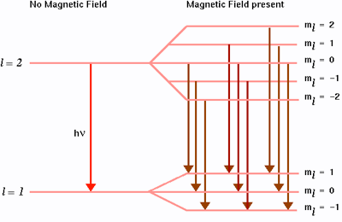

Spin Hamiltonian
$$\text{H} \text{=} g_{n}μ_{n} \text{B}⋅\text{I} +g_{e}μ_{e}B⋅S +A I⋅S \\ =nuclear zeeman+electron zeeman+hyperfine$$
B = magnetic field
I = nuclear spin operator
S = electron spin operator
We will be solving this eigenstate problem for one neutron and one electron. This is equivalent to a Phosphorus impurity in silicon with 1 bound electron (Quantum dot).

Slide 3
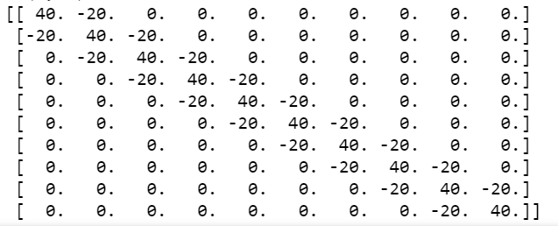
Sparse Matrix Representation
If a matrix is mostly zeroes, you convey all the information in it without needing to preserve the entire matrix structure:
These are called ‘sparse’ matrices, and they’re very common in computational physics

Slide 4
Sparsing a matrix
We’re going to use the scipy.sparse method to make sparse representation matrices.
There are a number of different ways to represent sparse matrices, see lectures for the differences.
We sparsify our matrix by calling the appropriate command:
If our matrix is H, then a List-In-List representation is scipy.sparse.lil_matrix(H)
Please have a look at the https://docs.scipy.org/doc/scipy/reference/sparse.html reference for the different type of sparsifications.

Slide 5
Doing things to a sparse matrix
You can’t just throw a sparse matrix into regular matrix operations.
There are special sparse-matrix methods out there (that are much quicker).
One of them is something we’ve talked about before: the Thomas Algorithm for tri-diagonal methods.
The sparse module has some specific ones that you can find here:
https://docs.scipy.org/doc/scipy/reference/generated/scipy.sparse.spmatrix.html#scipy.sparse.spmatrix
We use a couple of them in the tutorial.

Slide 6
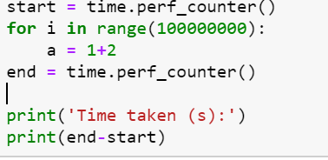
Timing operations
We’re going to use time.perf_counter() which is supposed to be for high performance stuff.
To time things, it’s pretty simple: use start = time.perf_counter() to get the start time, run the code, and then do end = time.perf_counter() to find the end time.

Slide 7
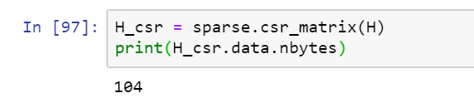
Getting the size of representations
One reason we use sparse matrix representations is that they are far more space efficient than regular matrix representations.
This is because we aren’t recording a tonne of zeroes.
We can determine how many bytes a particular numpy object uses by the command: <VARIABLENAME>.data.nbytes.
To get the size in kB, divide by 1024 (and to get MB, divide by 1024 squared)

